Slide 1
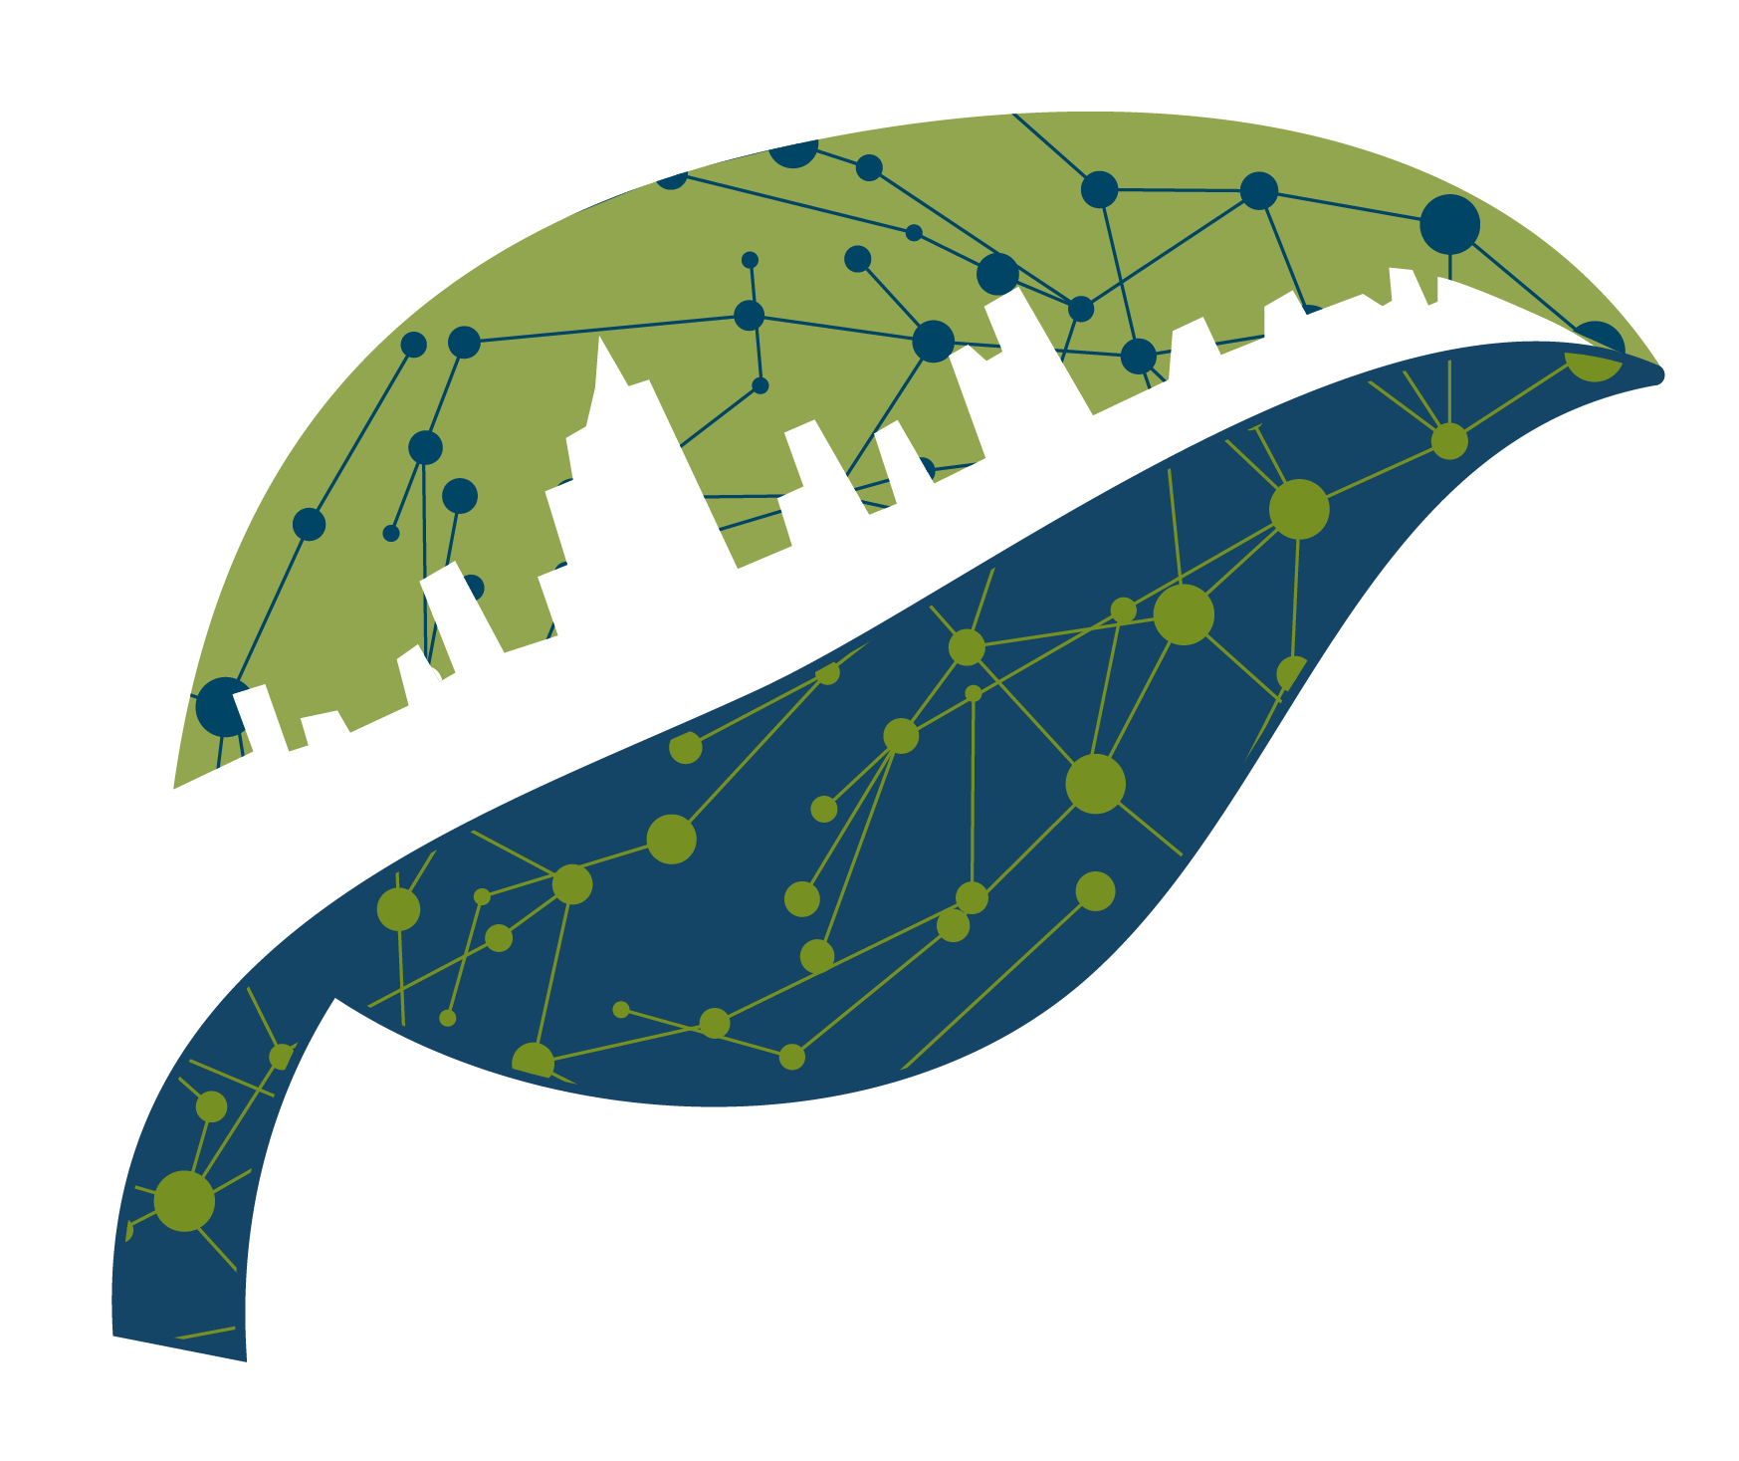
NATURA
Nature-based Solutions for Urban Resilience in the Anthropocene
Elizabeth Cook, Barnard College
Nancy Grimm, Arizona State University
Timon McPhearson, The New School
Yeowon Kim, The New School

Slide 2
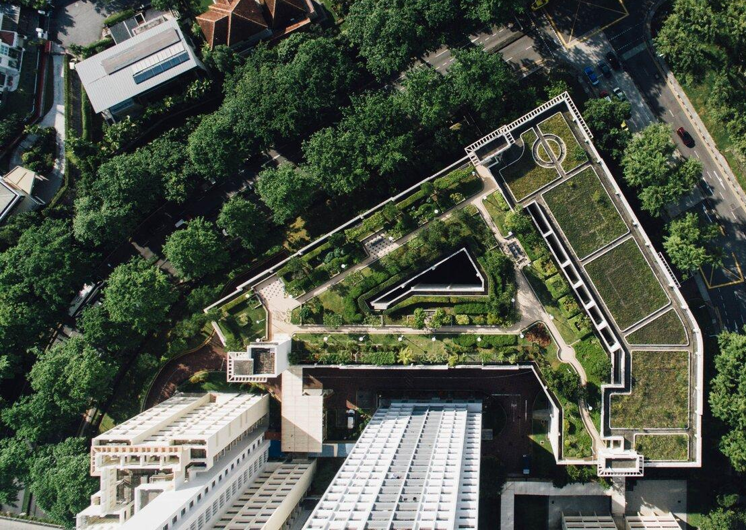
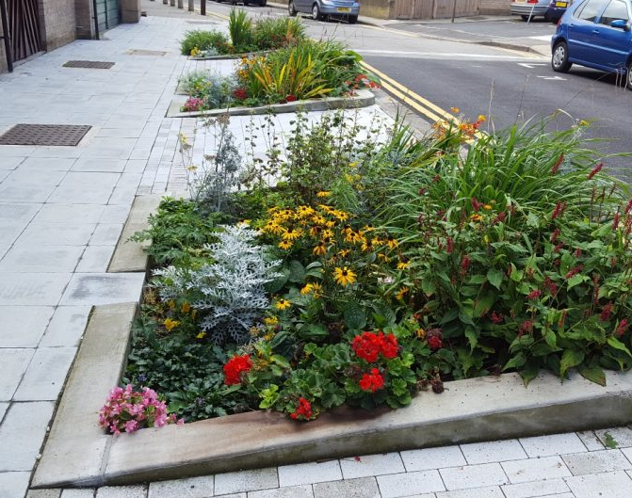
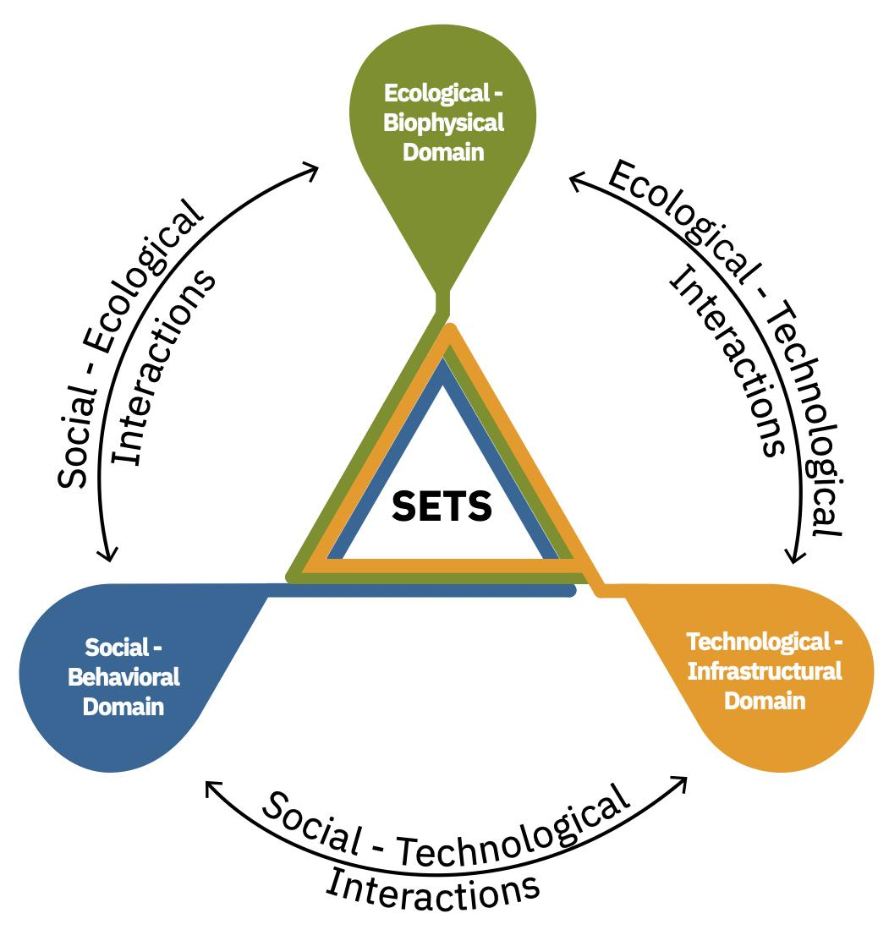
NATURA addresses five key knowledge gaps:
1. Synergistic benefits of bundles of NBS for urban resilience
2. Role of social-cultural (S) context in NBS outcomes
3. Role of ecological-biophysical (E) context
4. Role of technological-infrastructural (T) context
5. Role of SETS interactions in NBS outcomes
Nature-based Solutions for Urban Resilience the Anthropocene
natura-net.org | @natura_project

Slide 3
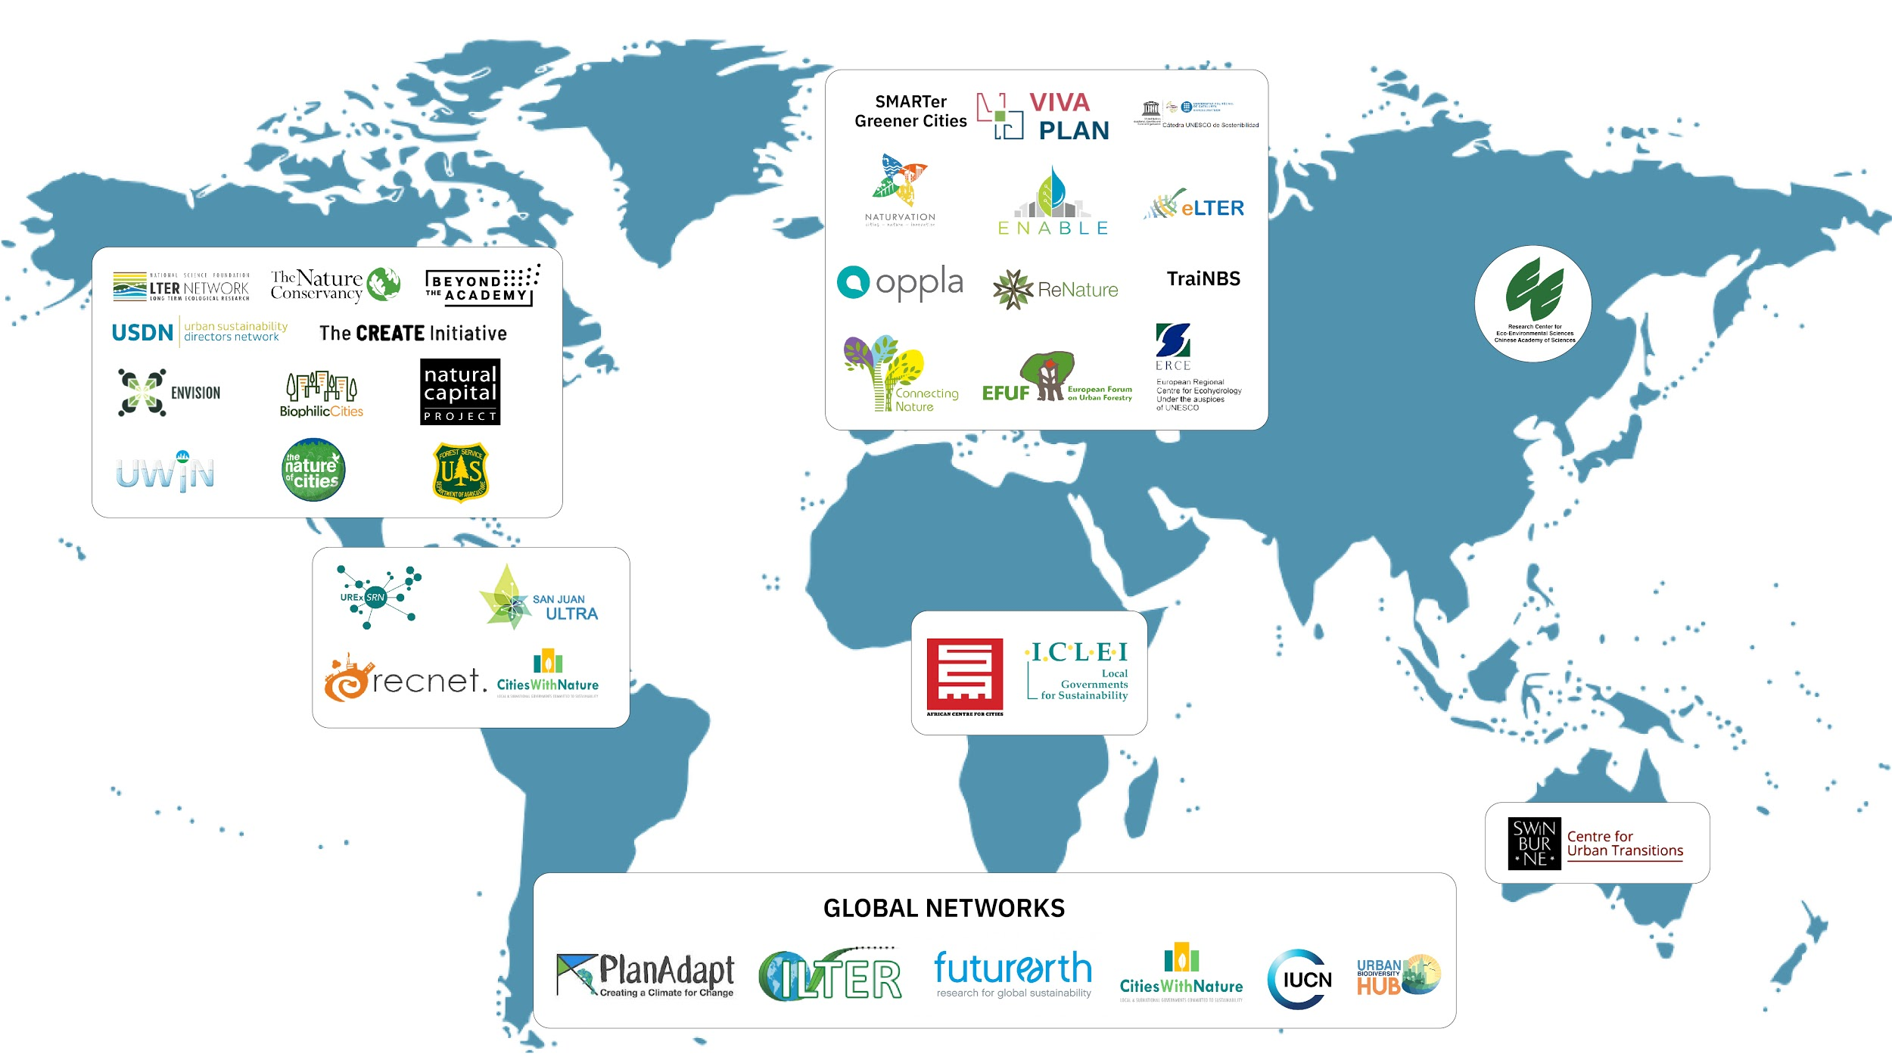
NATURA links over 30 global networks to enhance connectivity among the world’s nature-based solutions scholars and practitioners

Slide 4
NATURA activities
Monthly Webinars: dialogue and learn from global networks.
Thematic Working Groups: designed and led by NATURA members to deepen peer learning across global perspectives (natura-net.org/working-groups).
Regional Networks: regional-based network of networks to learn and synthesize across specific contexts.
Learning Exchanges: 6- to 15-week residencies at collaborating global networks for early-career academics and practitioners to further learning, synthesis, and networking (natura-net.org/learning-exchanges).
Early-Career Network: build and foster community for early career scholars and practitioners (natura-net.org/early-career-network).
Annual All-Hands Meeting: foster exchange and synthesis across all of our network partners (The Nature of Cities Festival (virtual), February 22-26, 2021).
Regular Communication: NATURA newsletter | natura-net.org | @natura_project

Slide 5
Successes and Lessons Learned

Slide 6
NATURA Network Dynamics and Growth

Slide 7
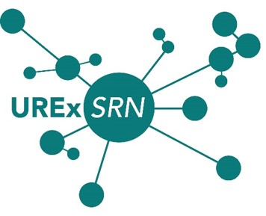
Cultivating a Diverse Network of Networks
From the initial launching of NATURA, the number of networks increased from 26 to 38.
Europe regional node increased from 8 members to 35 members
Africa regional node increased from 6 members to 41 members
Latin America regional node increased from 6 members to 64 members
North America regional node increased from 5 members to 47 members
FOUNDING NETWORKS
NEW NETWORKS ADDED IN 2020

Slide 8
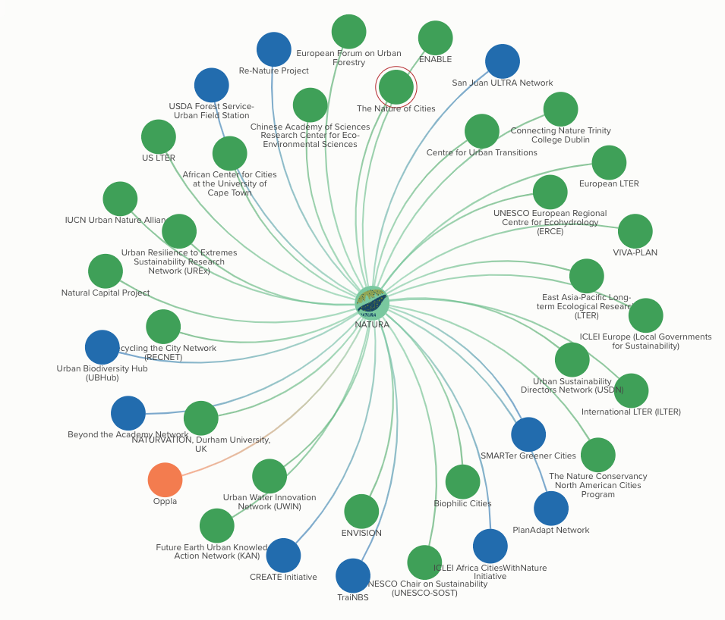
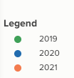
Network Change and Connectivity
Membership change from 2019 - 2021

Slide 9
Challenges

Slide 10
Key Challenges
Coordination across time zones and languages.
Adapting to COVID-19 - virtual meetings, cancellation of travel plans, and restructuring the Learning Exchange Residency program.
Virtual communication and sharing across networks and nodes
Diverse representation - less networks in Global South regions, especially in Latin America and Africa

Slide 11
Solutions and Best Practices

Slide 12
Democratic and Distributed Governance
Established an Executive Team and Coordinating Committee to assist in communicating with Regional Nodes, Thematic Working Groups and the network more broadly.
Regional Nodes meet in time zones that work best for those regions, and our networks have become proficient in Zoom meetings.
We also use Twitter, Slack and our NATURA-net.org website for communication.
REGIONAL NODES THEMATIC WORKING GROUPS
ASIA-PACIFIC
AFRICA
LATIN AMERICA
NORTH AMERICA
EUROPE
NATURA Design for Justice
Nature-Based Pathways
Global to Local
Urban Nature
Urban Informality
Integrating Urban NBS and the Sustainable Development Goals

Slide 13
Virtual Webinars and All-Hands Meeting
Due to COVID-19, we largely pivoted to a virtual webinar and meeting format
All-Hands Meeting was a virtual gathering.
During the All-Hands Meeting we used the “World Cafe” model to further promote the international and inclusive approach of the NATURA network of networks.
This model created a space to synthesize discussions and review emergent topics covered over the 2-day event.

Slide 14
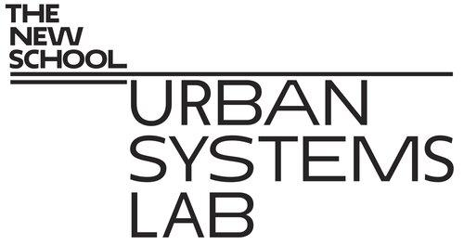
Learning Exchanges and Virtual Residency
Learning Exchange program, which would have supported international travel and the placement of researchers at sites around the world, is being reconceptualized to include a “virtual residency” option.
The NATURA Learning Exchange Program is a 6- or 15-week residency for research and networking at collaborating network institutions. The goal is to:
Provide opportunities for students, early-career academics, and practitioners to explore nature-based solutions for urban resilience by spending time in residence with other networks;
Support greater depth of analysis or synthesis by extending time of interaction;
Support practitioner-researcher interactions through exchanges among worldwide networks.
LEARNING EXCHANGE HOSTS

Slide 15
Early Career Network
The NATURA Early-Career Network was founded for NATURA network members pursuing an education or in the beginning stages of their careers
This network aims to build a community for EC members that will foster networking opportunities, sharing of information, and peer to peer support.

Slide 16
Next Steps and Remaining Concerns

Slide 17
Next Steps & Concerns
Learning Exchange Residencies
Continuing to diversify the network
Managing outputs and deliverables

Slide 18
Thank You!
timon.mcphearson@newschool.edu
www.natura-net.org
@natura_project

